Slide 1
Financial Literacy
Credit and More!

Slide 2

Introduction
Paul B. Smith
Market Manager & Vice President with Valley Bank
21 years in the banking field
Business Administration Degree – Middlesex County College
Business Degree from Kean University

Slide 3

Introduction
Christian Proscia
Senior Personal Banker & Supervisor with Valley Bank
15 years in the banking field
Communication & Media Specialist from Montclair State University

Slide 4
Credit & Credit History
Credit is defined as the ability to obtain a sum of money or something of value before payment with the trust that payment will be made at a later date.
A credit history is a record of an individual’s past experiences with repaying their credit obligations.

Slide 5
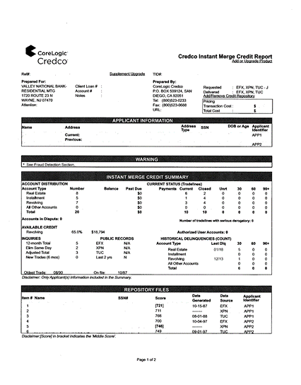
What is included in a credit report?
General personal information:
  Name
  Date of Birth
  Social Security Number
Includes loan account details for current and recently closed loans
  Mortgages
  Home Equity Loans
  Auto Loans
  Credit Cards
  Store Cards
  Student Loans

Slide 6
What is included in a credit report? (Cont’d)
Details about loans include:
  Name of creditor
  Account balances
  Credit limits for lines of credit (credit cards, store cards, home equity lines)
  Payment history
  Open and close dates of accounts
  Collection items

Slide 7
What is included in a credit report? (Cont’d)
Public Records:
  Bankruptcies
  Judgements
  Arrear child support payments
  Credit inquires

Slide 8
How long items appear on report?
Active accounts: As long as the account is open
Closed accounts in good standing: 10 years
Late payments: 7 years
Collection/Charge off accounts: 7 years
Chapter bankruptcies: 7 to 10 years
Arrear child support payments 7 years
Credit inquiries: 2 years

Slide 9
Credit Reports
Detailed account of an individual’s credit history
Three Credit Bureaus.
  Equifax - 1 (888) 378-4329
  Experian - 1 (888) 397-3742
  TransUnion - 1 (800) 916-8800
Information is supplied by banks, collection agencies and the government.
Information may differ between the three credit bureaus.
Everyone is entitled to 1x FREE copy of their credit report annual
  https://www.annualcreditreport.com/index.action

Slide 10
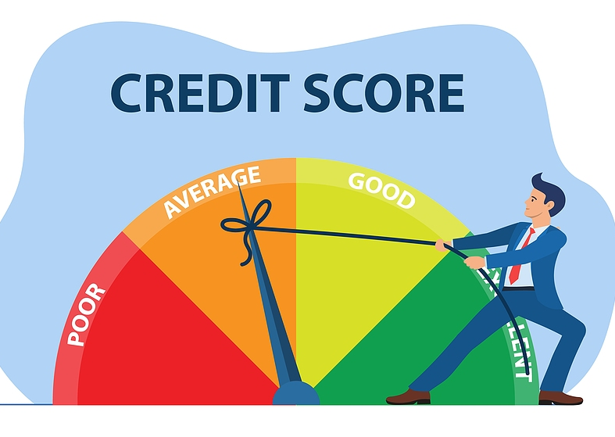
Mathematical algorithm that uses several factors that appear in a credit history.
Credit Score Range – 300 to 850
Used by financial institutions to determine whether you are qualified for a loan or credit card.
The higher your credit score, the more likely you will qualify for a loan and lower rates.
The higher your credit score, the more likely you will receive lower loan rates.

Slide 11

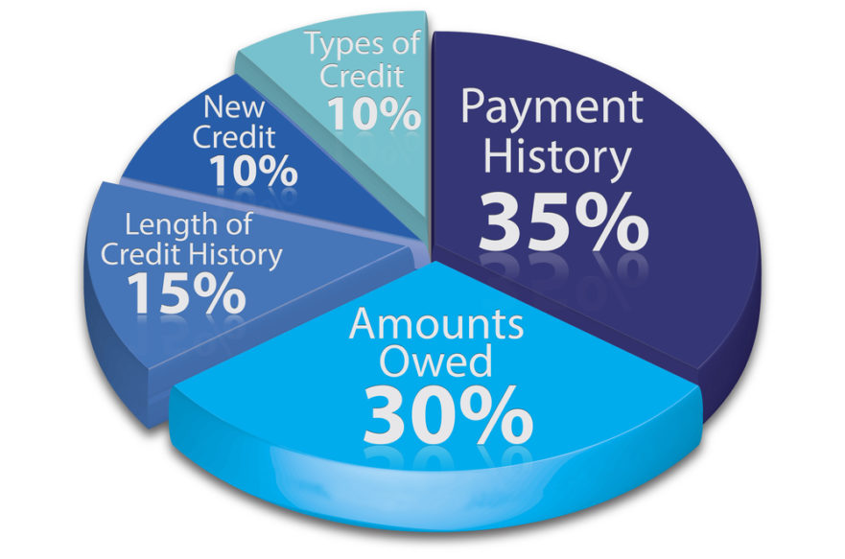
Payment history – Are loan payments consistently on time? Have there been some late payments?
Amounts owed – Credit utilization ratio* (Amount of line of credit balance/available credit) Looks at how much of your credit you have used versus your total credit limits. What percentage of your credit card are you using?
Length of credit – Amount of time that you have established credit accounts. How long has your loan account been open? The longer a loan appears on your credit, the better.
Credit mix – Do you have revolving (credit card, line of credit) and installment loans (Auto, student loans, mortgage)?
New Credit – Have you recently taken out a new loan? Have you recently applied for a new loan? Each time you apply for credit, it impacts your credit score. Credit inquiries lower your score a few points.

Slide 12
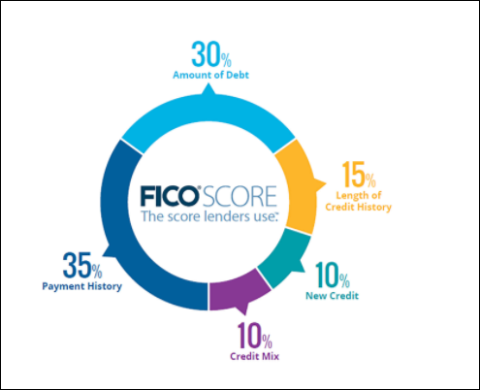

Slide 13
Credit utilization ratio example
Line of credit product | Total line limit | Outstanding balance
Credit Card #1 | $5,000 | $4,000
Credit Card #2 | $4,000 | $3,000
Store Card #1 | $3,000 | $500
Store Card #2 | $3,000 | $1,500
Home Equity Line | $10,000 | $6,000
Totals | $25,000 | $15,000
Total outstanding balance ($15,000) / Total line limits ($25,000)
= 60%

Slide 14
What is a good credit score?
750 - 850 | Excellent
700 - 749 | Good
650 - 699 | Fair
550 - 649 | Poor
300 - 549 | Very Poor
* According to Experian

Slide 15
How does your credit history affect you?
Ability to get a loan (auto, credit card, mortgage)
Interest rate that your bank offers on a loan
Auto / Homeowner Insurance Premiums
Ability to rent an apartment/home
Ability to get a job

Slide 16
How does your credit history affect you?
Example
Average Auto Loan rates by Credit Score Category
Credit Score | Average Rate - New Car (As of 1st Quarter 2021) | Monthly payments 5-year term, $10,000 loan amount | Total interest paid over 5 years.
720 or above | 5.18% | $189.94 | $1,396.40
660 - 719 | 6.40% | $195.71 | $1,742.60
620 - 659 | 8.86% | $207.66 | $2,459.60
580 - 619 | 11.53% | $221.12 | $3,267.20
579 or below | 14.08% | $234.44 | $4,066.40
* Source: July 5, 2023, Experian Article

Slide 17

Events that positively affect credit scores
Pay on time
Have a good credit mix. – (Auto/Mortgage/Credit cards/Etc)
Credit utilization ratio under 30% (Amount of line of credit balance to available credit)
Paying down credit balances
Time - Late payments, collection accounts, bankruptcies – the further they go into the past, your score will improve as long as they don’t happen again. Each year, the effect on credit scores lessens.
Waiting is not the ideal approach with a collection item. First attempt to pay, settle or dispute the item.

Slide 18

Events that negatively affect credit scores
Making late payments
Credit utilization ratio (Amount of line of credit balance to available credit) over 30%
Applying for new credit often throughout the year.
Never using your credit card resulting in the cards being cancelled by the credit card company.
Closing old credit cards

Slide 19

Rebuilding Your Credit

Slide 20
Ways to establish credit or rebuild credit
Get a secured credit card
Become an authorized user
  Will appear on your credit report as an authorized user
Use a co-signer when applying for a loan

Slide 21
Secure Credit Cards
Money must be deposited with the card issuer.
  - This will be used as the security account.
Used like a traditional credit card to make purchases.
Requires at least the minimum monthly payments as traditional credit cards.
Pay interest on unpaid balances as traditional credit cards.
Great option for establishing / rebuilding credit if payments are made on time.
Application approval is higher but NOT guaranteed.

Slide 22

Question?

